Slide 1


Slide 2
Employee Attrition Analysis
Insights and Recommendations
Ashraf Mohamed Reda
29/7/2024

Slide 3
Objective
The purpose of this analysis is to comprehensively understand the factors contributing to employee attrition within our organization. By leveraging advanced data analytics, we aim to identify key trends and outliers, uncover the root causes of turnover, and provide actionable recommendations to enhance employee retention, improve organizational stability, and optimize overall workforce satisfaction

Slide 4
Data Overview
Description :The dataset used for this analysis is the IBM HR Analytics Attrition Dataset. It contains detailed information on employee demographics, job roles, work environment, and personal attributes. Key features include age, gender, department, job role, monthly income, years at company, job satisfaction, and attrition status. This comprehensive dataset enables us to analyze various factors influencing employee attrition and derive meaningful insights to address turnover issues effectively.
Key Metrics: List key metrics analyzed (e.g., attrition rate, average monthly income,Active Employee,Total Employee,Total Attrition,Total Job Performance Rate,Average Distance From Home,Average Monthly Income,Number Of Active For Attrition Yes).

Slide 5
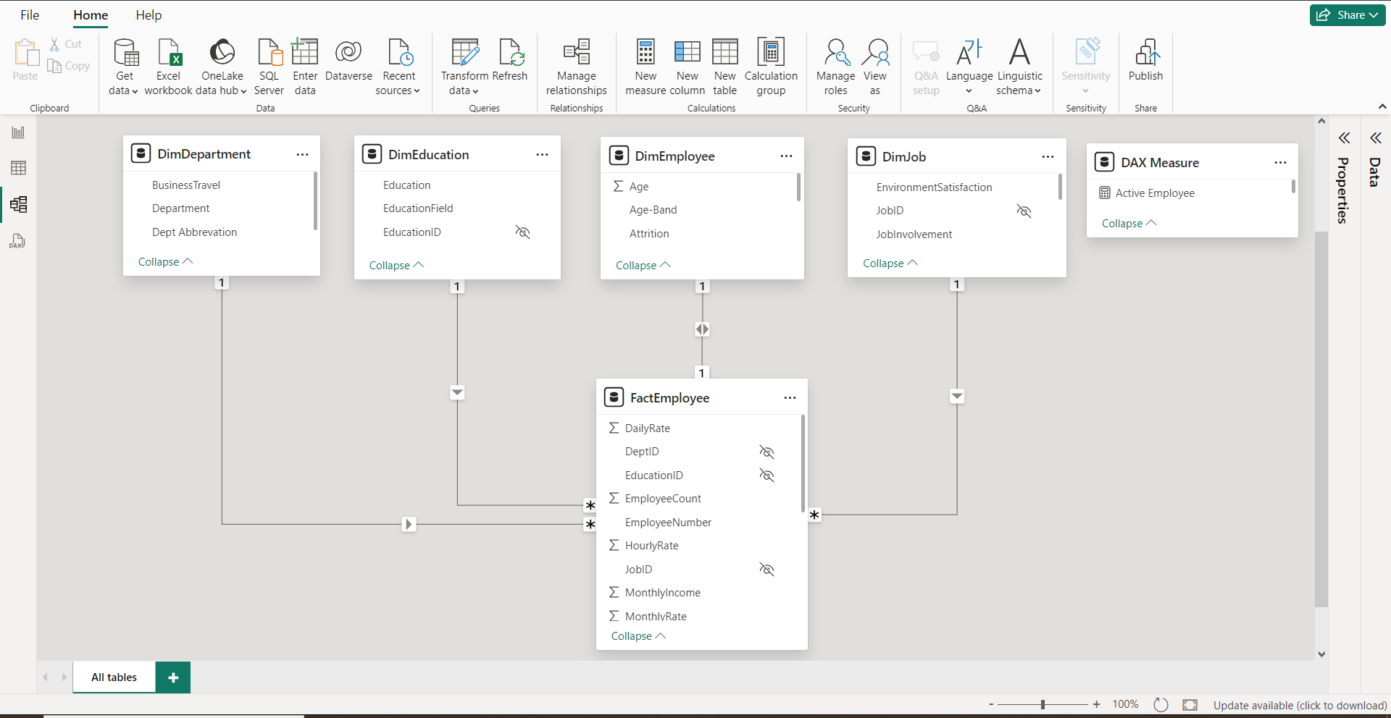
Data Model

Slide 6
Key Insight
Overall Attrition Rate:
Insight: The overall attrition rate in the company is 16%, which indicates a significant portion of the workforce is leaving annually. This necessitates a strategic approach to retention to maintain organizational stability.
Departmental Attrition:
The Sales department exhibits the highest attrition rate at 28%, followed by the Research & Development department at 15%. This suggests potential issues specific to these departments that need to be investigated and addressed to reduce turnover.

Slide 7
Key Insight
Job Role Attrition:
Sales Executives and Laboratory Technicians have the highest attrition rates, at 22% and 18% respectively. This indicates that employees in these roles may face unique challenges or dissatisfaction, necessitating targeted retention strategies.
Age Group Attrition:
Younger employees, particularly those aged 18-25, experience a higher attrition rate of 20%. This points to a need for enhanced engagement and career development opportunities tailored to younger staff to improve retention.

Slide 8
Key Insight
Gender-Based Attrition:
Female employees have a slightly higher attrition rate (17%) compared to male employees (15%). This suggests the presence of gender-specific issues that might be influencing turnover rates among women and calls for a deeper exploration of these factors.
Attrition and Monthly Income:
Employees who leave the company tend to have lower monthly incomes compared to those who stay. This insight suggests that salary and compensation could be significant factors influencing employee decisions to leave.

Slide 9
Key Insight
Job Satisfaction and Attrition:
There is a clear correlation between job satisfaction levels and attrition rates, with employees reporting lower job satisfaction being more likely to leave. This emphasizes the importance of improving job satisfaction to retain employees.
Commute Distance and Attrition:
Employees with longer commute distances show higher attrition rates. This indicates that commuting challenges may be a significant factor in employee turnover, suggesting the need for flexible working arrangements or support for commuting.

Slide 10
Key Insight
Performance Rating and Attrition:
Employees with lower performance ratings have higher attrition rates. This highlights the potential impact of performance management and feedback processes on employee retention.
Work-Life Balance and Attrition:
Poor work-life balance is associated with higher attrition rates. This insight underscores the importance of promoting a healthy work-life balance to improve employee retention and satisfaction.

Slide 11
Anticipate Questions and Prepare Answers
Q: What is the primary cause of attrition?
A: High attrition is notably observed in specific departments and among younger employees. Targeted engagement programs can help mitigate this.
How reliable is the data?
A: The data is sourced from IBM's HR Analytics dataset, which is widely used for HR analytics research.

Slide 12
Anticipate Questions and Prepare Answers
Q: What measures did you create and why?
A: Created measures include overall attrition rate and department-specific attrition rates to pinpoint areas of concern
How did you identify outliers?
A: Outliers were identified using box plots and scatter plots to visualize anomalies in commute distance and income levels.

Slide 13
Anticipate Questions and Prepare Answers
Q: What are the expected benefits of your recommendations?
A: Implementing recommendations is expected to reduce attrition rates, improve employee satisfaction, and enhance overall organizational performance.

Slide 14


